Slide 1



Early childhood development
What do Quebecers expect from their government?
Survey conducted by Léger – Early Childhood Observatory
Web survey • 2,541 adults across Québec
August 4-19, 2022

Slide 2

Our mission
The Early Childhood Observatory is a project of the Lucie and André Chagnon Foundation.
Our mission
Communicate the current state of knowledge in order to promote informed decision-making on the subject of early childhood in Québec.
Our ultimate goal
Ensure that every young child living in the province has access to conditions that will enable them to develop their full potential.

Slide 3

Survey results
What Quebecers expect from their newly elected government in the area of early childhood development.
Almost 9 out of 10 Quebecers
... think the Québec government should invest more to foster the welfare and development of children between the ages of 0 and 5 (87%).
... think that the Québec government should do more to support children in vulnerable families (89%).

Slide 4
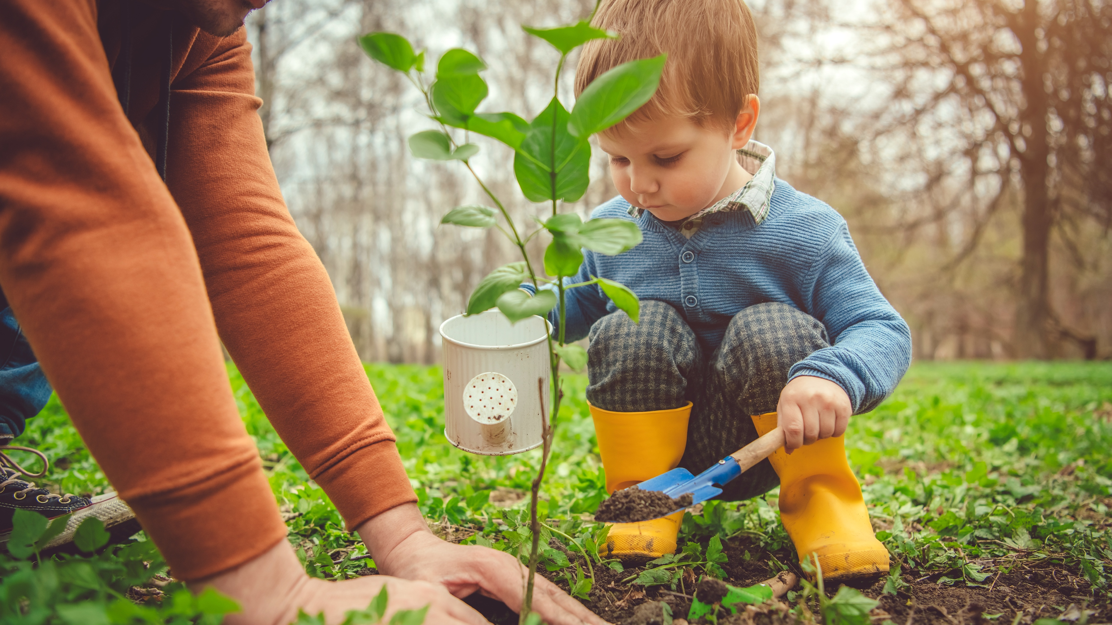
Investment
priorities

Slide 5

Investment priorities
Across various issues affecting young children, Quebecers chose these three investment priorities for the gouvernment:
1
Access to affordable housing for families (32%)
Preventing child maltreatment (29%)
Improving access to health and social services specialists for families with young children (27%)
2
3

Slide 6

Investment priorities
1
Access to affordable housing for families
Almost
1 out of 3 Quebecer
think that access to affordable family housing
should be one of the gouvernment’s three top investment priorities (32%).

Slide 7

Investment priorities
Access to affordable housing for families
The impact of unaffordable housing*
on parents and young children
Living in unaffordable housing can affect young children’s development. It is linked to a greater risk of delay in physical, emotional, cognitive, language and social development in children.
For example, it has been observed that young children who live in housing that is too expensive for their parents are often underweight compared to other children in their age group because their parents have little money to devote to basic needs, such as food.
* According to the Canada Mortgage and Housing Corporation (CMHC), a dwelling is considered unaffordable if a household spends more than 30% of its income before taxes on housing costs.

Slide 8
Investment priorities
Access to affordable housing for families
Living in housing that is beyond the family’s means is also a source of stress. Since accumulated stress has an impact on parents, it also affects their children. Stress makes parents less available to respond to their children’s needs. By decreasing their mental availability, their feelings of competence and parental sensitivity, stress reduces the amount of attention that parents are able to give their child.
Living in an environment that offers affordable dwellings of a suitable size in a safe neighbourhood has a positive influence on both parents’ ability to care for their children and young children’s mental health.

Slide 9
Investment priorities
Access to affordable housing for families
Something can be done to improve families’ access to affordable, suitable housing
Scientific literature tells us that it is possible to take measures that could increase families’ access to affordable, suitable housing—for example, by exerting stricter control over rent increases and improving access to social housing.
Unlike Canada, several European countries have high percentages of social housing. By way of comparison, Québec, which has a population comparable to that of Austria, has nearly 160,000 social and community housing units, while Austria has 900,000.

Slide 10
Investment priorities
Access to affordable housing for families
It is also possible to give priority to housing that has been developed based on families’ needs as a living environment, close to services and green spaces.
For example, Le Concerto, a three-storey building with 13 affordable units designed for families, couples or people living alone, was inaugurated in Lac-Mégantic in June 2019. Le Concerto also houses a daycare with both regular and atypical (evening) hours, a drop-in daycare, and a playground for 0–12-year-olds.

Slide 11

Investment priorities
2
Preventing child maltreatment
Close to
1 out of 3 Quebecers
Considers that preventing child maltreatment should be one of the government’s top three priority investments in the area of early childhood (29%).

Slide 12

Investment priorities
Preventing child maltreatment
The impact of maltreatment on young children
Children victims of maltreatment during early childhood can develop attachment difficulties, cognitive and language delays.
Over the long term, being a victim of maltreatment in childhood is associated with:
poorer academic performance and results
financial precarity in adulthood
Physical and mental health problems

Slide 13


Investment priorities
Preventing child maltreatment
It is possible to take action to prevent maltreatment of young children by diminishing pressure on families
Stress related to family-work balance
Improving living conditions and reducing sources of stress for families can help to prevent child maltreatment.
Conditions in which young children grow up can influence the risk of maltreatment. As sources of stress pile up, the risk of maltreatment increases.
Low income
Poor social support
Symptoms of depression in parents
Parents’ excessive use of alcohol or drugs
Family-work balance measures
Access to quality educational childcare services
Housing support
Income supplements
Social support
13 SECTION 1 – Investment priorities

Slide 14

Investment priorities
3
Improving access to health and social services specialists for families with young children
A little more than
one-quarter of Quebecers
consider that improving access to health and social service specialists* for families with young children should be one of the government’s top three priority investments in the area of early childhood (27%).
*I.e.: mental health resources, social workers, speech therapists, nutritionists, etc.

Slide 15

Investment priorities
Improving access to health and social services specialists
The impact of not having access to specialists for young children
Research has shown that having timely access to health and social services is critical for young children. Inadequate access to health care is linked to increased pain, complications, and emotional distress in this age group. This can compromise the child development.

Slide 16
Investment priorities
Improving access to health and social services specialists
For example, a child who is having speech difficulties and is unable to see a speech therapist will be at greater risk of developing problems related to behaviour, academic performance, and social adaptation. Language development is essential for the acquisition of good social skills and academic learning.
Similarly, a child with special needs living with a motor development disorder may experience negative consequences if they do not have access to a physiotherapist. The pain they have to live with can greatly restrict their movement, preventing them from attending daycare or participating in cultural or recreational activities. Such restrictions can have a negative impact on their overall development, ultimately affecting their quality of life in adulthood.

Slide 17

Investment priorities
Improving access to health and social services specialists
Something can be done to improve access to specialists for young children
A study conducted with CPE educators showed that partnering services provided by an occupational therapist enabled them to be better equipped to identify and work with children with special needs. This system ensures that children are more rapidly referred to appropriate services.

Slide 18
Investment priorities
Improving access to health and social services specialists
The report “Agir pour que chaque tout-petit développe son plein potentiel” proposes solutions to reduce access barriers for disadvantaged families.
A few examples:
  ensuring that all families receive information about services
  providing interpreters or allowing more time to create relationships of trust
  providing training for service providers in order to reduce negative attitudes towards these families

Slide 19

Concerns regarding vulnerable children and families

Slide 20

The Québec population is concerned about vulnerable children and families
Close to
9 out of 10 Quebecers
think the government should do more to support children living in vulnerable families (89%).
20 SECTION 2 – Vulnerable children and families

Slide 21

Concerns
Regarding vulnerable children and families
87% of Quebecers
think that the Québec government should invest more in order to improve access to services for children with disabilities or special needs.
87% of Quebecers
think that all pregnant women should have access to prenatal care covered by the Régie de l’assurance-maladie du Québec, regardless of their immigration status.
21 SECTION 2 – Vulnerable children and families

Slide 22

Concerns
Regarding vulnerable children and families
92% of Quebecers
think that children’s living conditions—including housing, their parents’ financial situation and food insecurity—have an effect on their educational success*.
* Educational success can be defined as the expression of a child’s ability to develop their full potential in every aspect of their life: physical, intellectual, emotional, social, and moral.
22 SECTION 2 – Vulnerable children and families

Slide 23
Concerns
Regarding vulnerable children and families
Quebecers are also concerned about access to quality educational childcare services
According to survey respondents, the government’s two main priorities in this area should be:
ensuring that children from low-income families have access to such services (28%).
guaranteeing spaces for children who are in vulnerable situations or at risk of maltreatment (26%).
23 SECTION 2 – Vulnerable children and families

Slide 24
Concerns
Regarding vulnerable children and families
Attending a quality educational childcare service in early childhood helps to equalize opportunities and could even reduce the gap in academic results between children from disadvantaged neighbourhoods and their middle-class counterparts
24 SECTION 2 – Vulnerable children and families

Slide 25

Early childhood:
a common cause

Slide 26

Early childhood:
a common cause
Every level of government and every sector of society—from the community to business—can have an influence on families’ living conditions and early childhood development.
It is essential that our youngest citizens start out with the best possible chances on their side.
26 SECTION 3 – A common cause

Slide 27


A common cause
Municipalities
Municipalities
A little over three-quarters of respondents (76%) think that municipalities should invest more in promoting young children’s well-being and development.
Areas where municipalities could be doing more, according to respondents:
  Social housing (54%)
  Safe living environments (42%)
  Transport and mobility (30%)
What can be done:
Our brochure Avez-vous pensé à vos plus
petits citoyens ?
27 SECTION 3 – A common cause

Slide 28
A common cause
Employers
Employers
Almost 3 out of 4 respondents (74%) think that employers should invest more in fostering young children’s well-being and development.
34% would be in favour of more companies offering family-work balance measures.
20% would like to see companies diversify the family-work balance measures they already offer.
25% would be in favour of managers being trained and equipped to provide their employees with better support in terms of family-work balance.
What can be done:
Les mesures
de conciliation
famille-travail
28 SECTION 3 – A common cause

Slide 29
A common cause
Community organizations
Community organizations
More than
8 out of 10 respondents
agree that the government should improve financial support for community organizations* that support families (84%).
To learn more:
Portrait des politiques publiques 2021 –
Chapitre sur le soutien aux organismes communautaires.
* Family houses, breasfeeding support groups, food banks, etc.
29 SECTION 3 – A common cause

Slide 30
A common cause
Community organizations
20% of parents with children
between the ages of 0 and 5 take advantage of services offered by community organizations.
Reasons to take advantage of services
  Because the services meet one of their own needs or those of their family (44%).
    61% among families with an annual income of under $40,000.
  Activities offered reflect their reality (21%).
  Because they boost their confidence in themselves and in their role as a parent (13%).
30 SECTION 3 – A common cause

Slide 31

A common cause
Community organizations
Across parents who do not use community services…
The vast majority say they don’t need them (80%).
9% say they are unaware of services offered by organizations in their community.
The corresponding figure among immigrants is 24%, and 26% among families with an annual income of under $40,000.
31 SECTION 3 – A common cause

Slide 32
Societies that invest in early childhood and families have the highest standards of health and the lowest levels of inequality in the world.
32

Slide 33
Methodology
The web survey was conducted between August 4 and 19, 2022, with 2,541 respondents who met the following criteria:
  Resident of the province of Québec
  Aged 18 or over
  Able to express themselves in French or English.
Oversampling was applied to the group of parents of children between the ages of 0 and 5 in order to do a profile analysis.
To ensure a representative sample of the population being studied, survey results were weighted based on the most recent data from Statistics Canada data, according to age, sex, region, mother tongue, presence of minors in the home, and level of education.
For information purposes, a probability sample of 2,541 respondents would have a margin of error of de +/- 1.9%, 19 times out of 20.
33 Methodology

Slide 34
References
AIZER, A., et J. CURRIE. « The intergenerational transmission of inequality: Maternal disadvantage
and health at birth », Science, vol. 344, nº 6186, 2014, p. 856-861.
CARROLL, A., et al. « Housing Instability and Children’s Health Insurance Gaps », Academic Pediatrics, vol. 17, nº 7, 2017, p. 732-738.
COLEY, R.L., et M. KULL. « Cumulative, Timing‐Specific, and Interactive Models of Residential Mobility and Children’s Cognitive and Psychosocial Skills », Child Development, vol. 87, nº 4, 2016,
p. 12041220.
CORAPCI, F., et T.D. WACHS. « Does parental mood
or efficacy mediate the influence of environmental chaos upon parenting behavior? », Merrill-Palmer Quarterly, vol. 48, nº 2, 2002, p. 182-201.
CROTEAU, C., et al. « Life habits of school-aged children with specific language impairment
as perceived by their parents and by school professionals », Journal of Communication Disorders, vol. 58, 2015, p. 21-34.
DAGENAIS, F., et J.-P. HOTTE. Rapport préliminaire du comité-conseil Agir pour que chaque tout-petit développe son plein potentiel, Montréal, Québec, 2019.
DONG, M., et al. « Childhood Residential Mobility
and Multiple Health Risks During Adolescence and Adulthood: The Hidden Role of Adverse Childhood Experiences », Archives of Pediatrics & Adolescent Medicine, vol. 159, nº 12, 2005, p. 1104-1110.
GAUDREAU, Louis, Guillaume HÉBERT et
Julia POSCA. Analyse du marché de l’immobilier
et de la rentabilité du logement locatif, [En ligne], 2020. [https://cdn.irisrecherche.qc.ca/uploads/publication/file/Logement_2020_WEB.pdf].
GILBERT, R., et al. « Burden and consequences
of child maltreatment in high-income countries »,
The Lancet, vol. 373, nº 9657, 2009, p. 68-81.
GLOBERMAN, Steven. Reducing Wait Times for
Health Care: What Canada Can Learn from Theory
and International Experience, Fraser Institute, 2013.
JELLEYMAN, T., et N. SPENCER. « Residential mobility in childhood and health outcomes: A systematic
review », [En ligne], Journal of Epidemiology and Community Health, vol. 62, nº 7, 2008, p. 584-592. [http://jech.bmj.com/content/62/7/584.full.pdf].
INSTITUT CANADIEN D’INFORMATION SUR
LA SANTÉ. Les soins de santé au Canada 2012 : regard sur les temps d’attente, Ottawa, ICIS, 2012.
34 References

Slide 35
MAHARAJ, V., et al. « Tackling child health inequalities due to deprivation: Using health equity audit to improve and monitor access to a community paediatric service », Child: Care, Health and Development,
vol. 40, nº 2, 2014, p. 223-230.
MICHALLET, B., et P. BOUDREAULT. « Démarche novatrice d’évaluation des besoins des enfants
et adolescents dysphasiques et stratégies d’intervention », Revue canadienne d’orthophonie
et d’audiologie, vol. 38, nº 1, 2014, p. 58-70.
NATIONAL CHILD AND YOUTH HEALTH COALITION. Children wait too: National Paediatric Surgical Wait Times Strategy, Final Report, 2006.
NORMAN, R.E., et al. « The long-term
health consequences of child physical abuse,
emotional abuse, and neglect: A systematic
review and meta-analysis », PLoS Medicine,
vol. 9, nº 11, 2012, e1001349.
[https://doi.org/10.1371/journal.pmed.1001349].
OBSERVATOIRE DES TOUT-PETITS. Petite enfance : la qualité des services éducatifs au Québec, Montréal, Québec, Observatoire des tout-petits, 2018.
OBSERVATOIRE DES TOUT-PETITS. Violence
et maltraitance : les tout-petits québécois sont-ils
à l’abri ?, Montréal, Fondation Lucie et André Chagnon, 2017.
OCDE. « Base de données : Logement abordable ». [www.oecd.org/fr/social/base-de-donnees-logement-abordable/].
PERREAULT, Kadija, et autres. Livre blanc sur l’accès aux services de physiothérapie au Québec : constats et cibles d’action pour mieux répondre aux besoins
de la population, [En ligne], Association québécoise
de la physiothérapie, 2019. [https://www.aqp.quebec/livre-blanc-sur-lacces-aux-services-de-physiotherapie-au-quebec/#:~:text=Le%20Livre%20blanc%20rend%20compte,qualit%C3%A9%20de%20vie%20et%20la].
SOCIÉTÉ CANADIENNE D’HABITATION
ET DE LOGEMENT. À propos du logement
abordable au Canada, [En ligne], 2018. [https://www.cmhc-schl.gc.ca/fr/professionals/industry-innovation-and-leadership/industry-expertise/affordable-housing/about-affordable-housing/affordable-housing-in-canada#:~:text=
Au%20Canada%2C%20un%20logement%20est,revenu%20avant%20imp%C3%B4t%20du%20m%C].
SYLVESTRE, A., et a. « Social participation of children age 8-12 with SLI », Disability and Rehabilitation,
vol. 38, nº 12, 2016, p. 1146-1156.
VERREAULT, C. L’ergothérapeute comme accompagnateur auprès d’intervenants d’un centre
de la petite enfance : une approche prometteuse, Dissertation doctorale, Université du Québec
à Trois-Rivières, 2016.
VILLE LAC-MÉGANTIC. « Le Concerto ». [https://www.ville.lac-megantic.qc.ca/services-aux-citoyens/finances/le-concerto/].
35 References

Slide 36


To keep in touch with the
Early Childhood Observatory
Newsletter:
tout-petits.org/infolettre
Social media:
tout-petits.org
Facebook
Twitter
Linkedin
Youtube
© Fondation Lucie et André Chagnon

